Slide 1

Scheduling Analysis of Limited-Preemptive Moldable Gang Tasks
Joan Marcè i Igual
Daily Supervisor
Geoffrey Nelissen
Co-supervisor
Mitra Nasri
20th of May, 2020

Slide 2
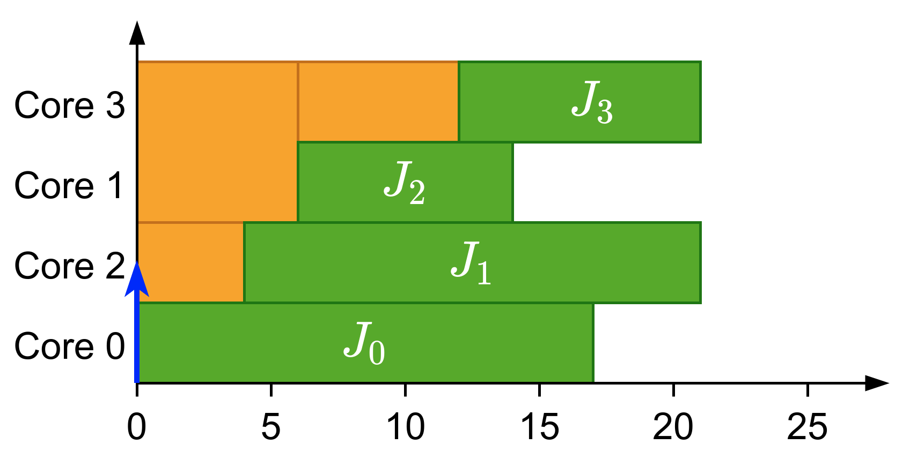
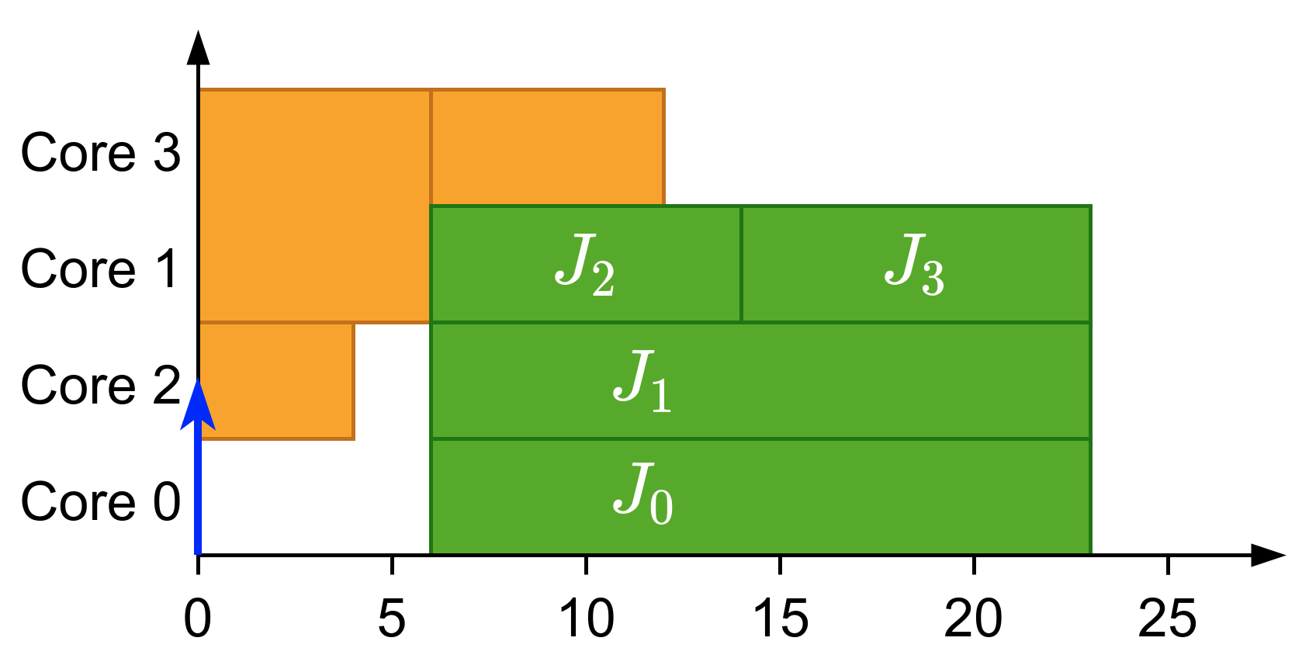
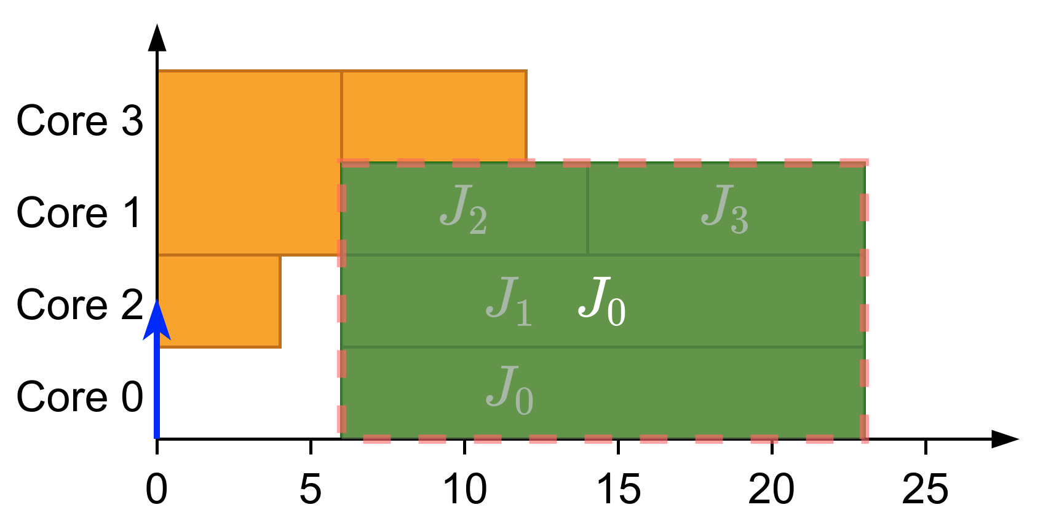
What is gang?
Parallel threads executed together as a “gang”
Execution does not start until there are enough free cores
Global scheduling
Gang Scheduling
Notes:
Multiple related threads
Execute them together as a “gang”
Form a single job

Slide 3
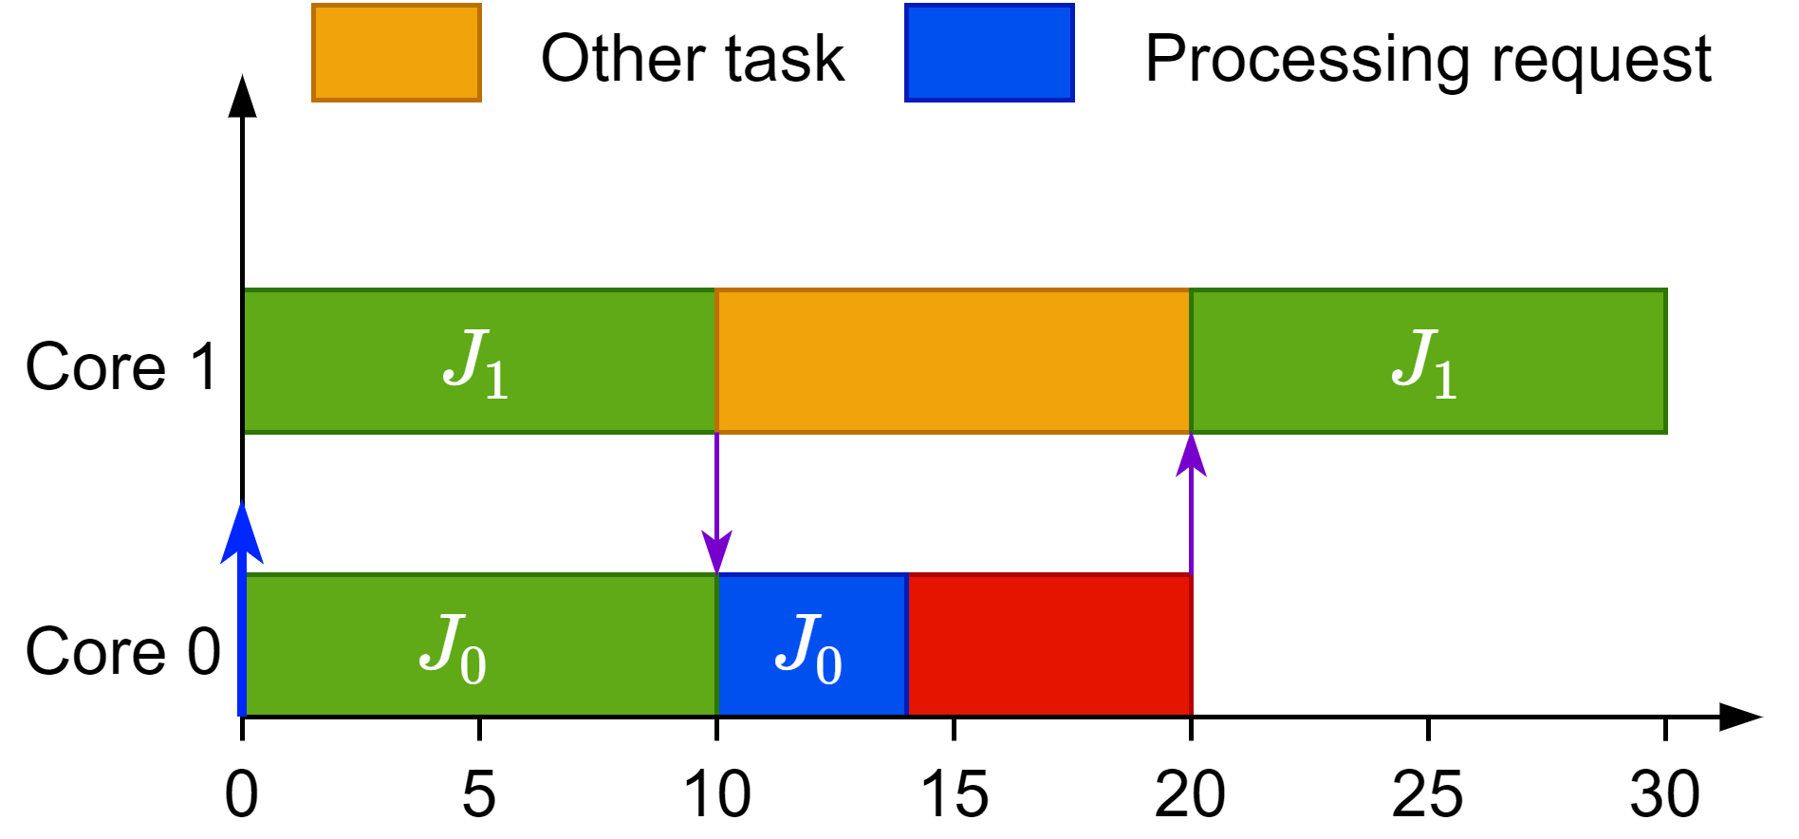
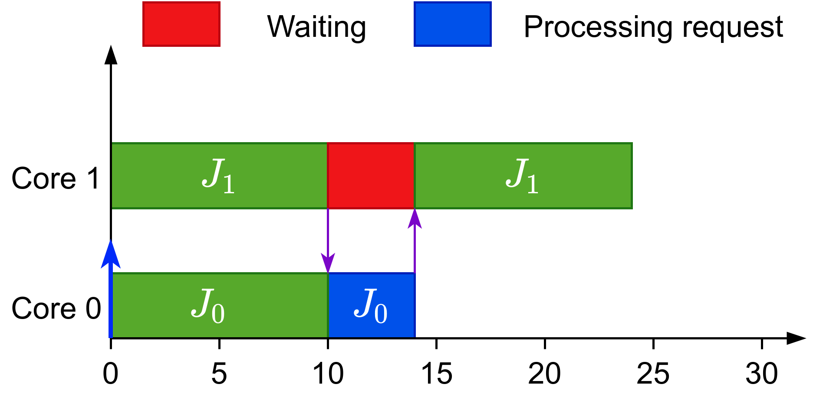
Why gang?
Efficient synchronization
Global scheduling
Gang Scheduling
Notes:
Gang looks worse but it actually has advantages:
Global scheduling would be pre-empted when waiting for synchronization
Gang scheduling would busy wait and for the reply
Example
Parallel SAT solvers use multiple threads that synchronize regularly to share learned clauses

Slide 4
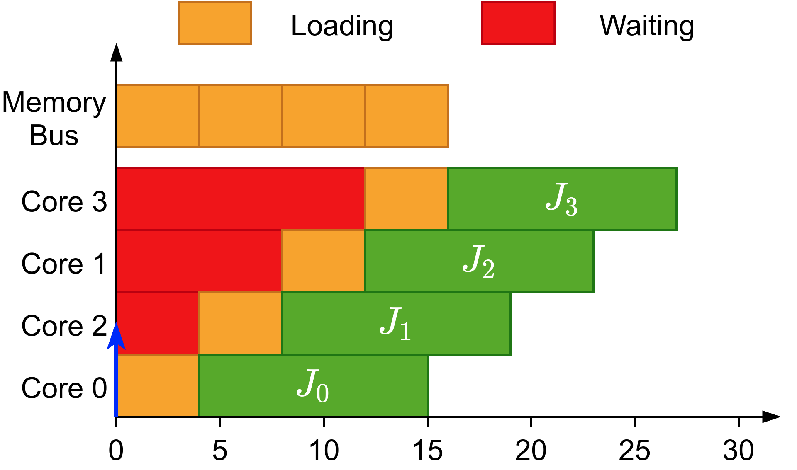
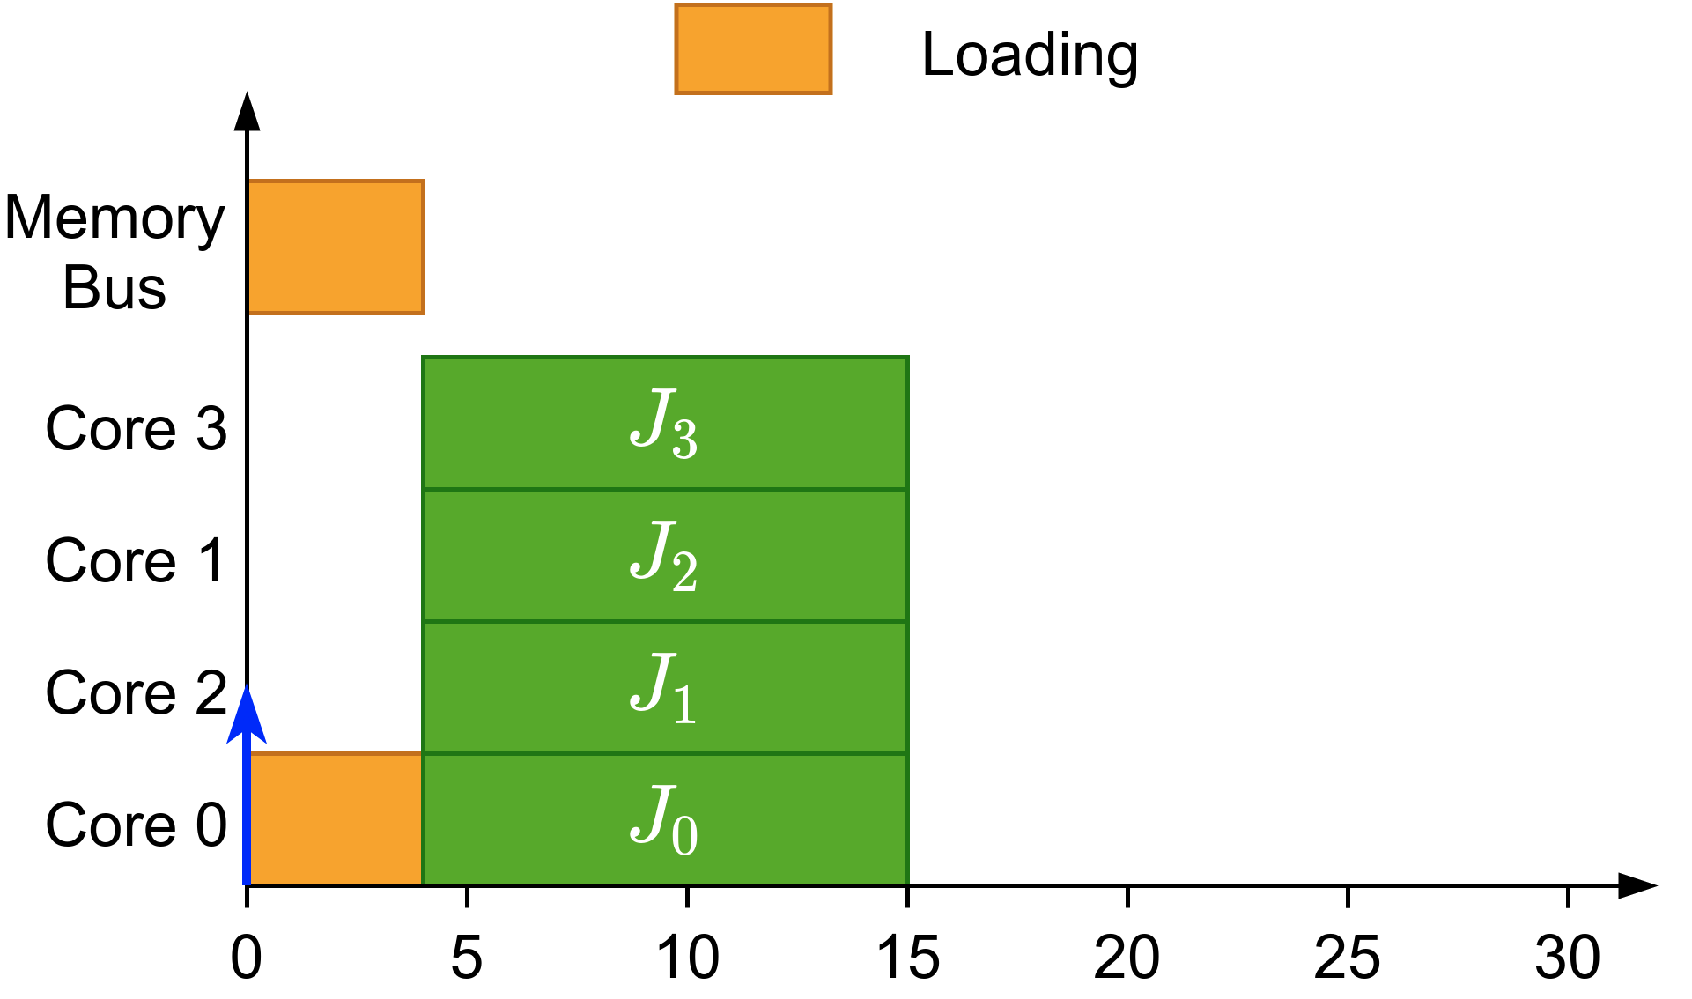
Why gang?
Efficient synchronization
Avoids overhead when loading initial data
Shows its full potential when executed non-preemptively
Global scheduling
Gang Scheduling
Notes:
Global scheduling would load the same data multiple times
Gang scheduling would load the data once for all the jobs
This is more evident in non-preemptive execution

Slide 5
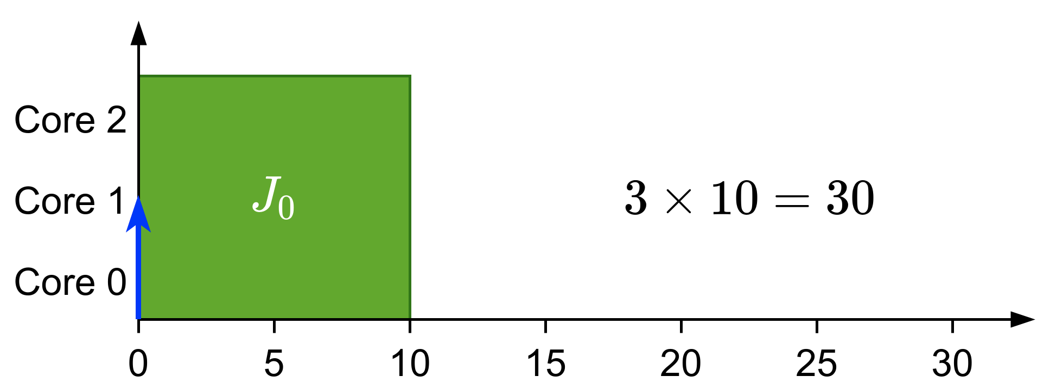
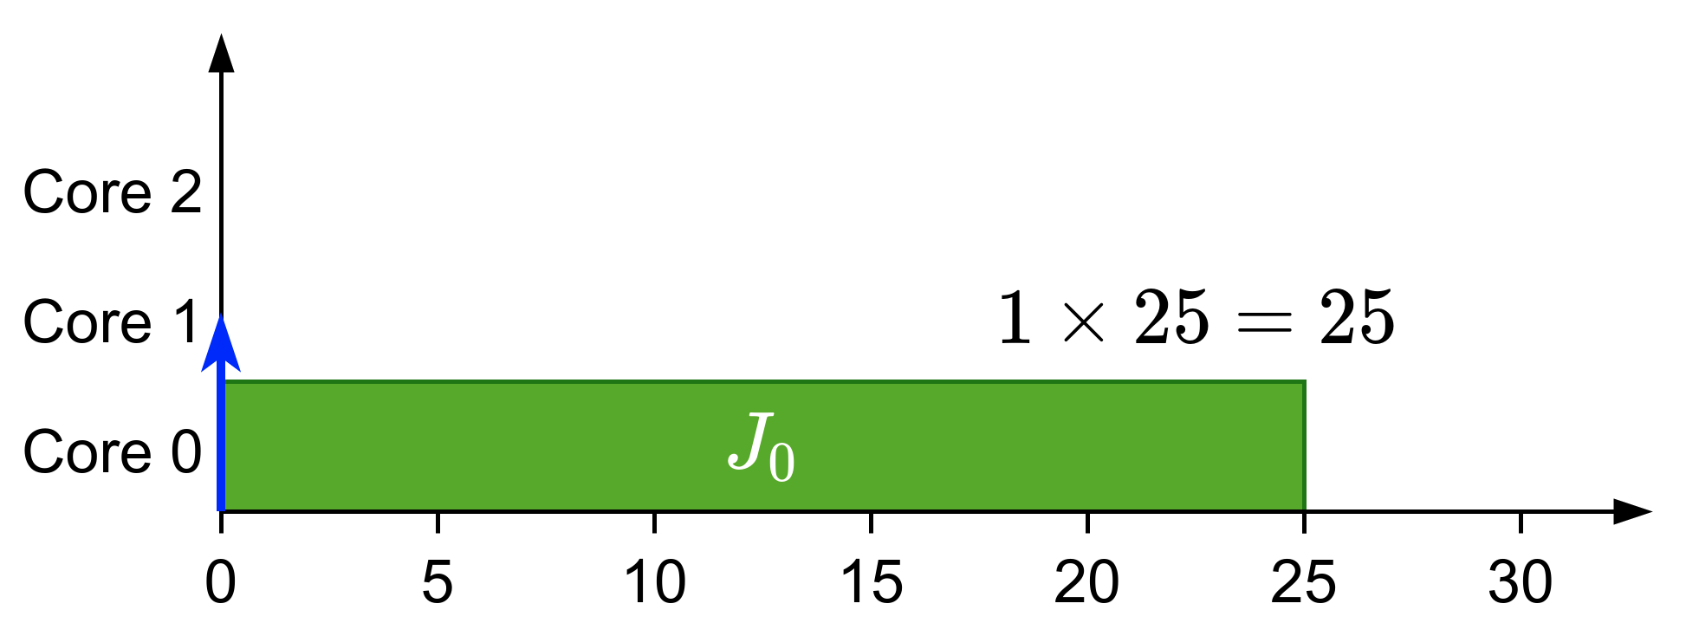
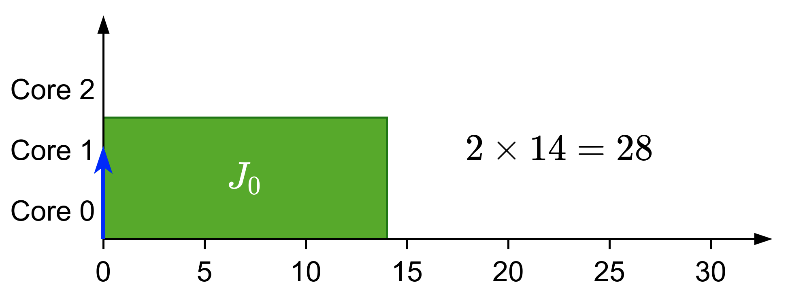
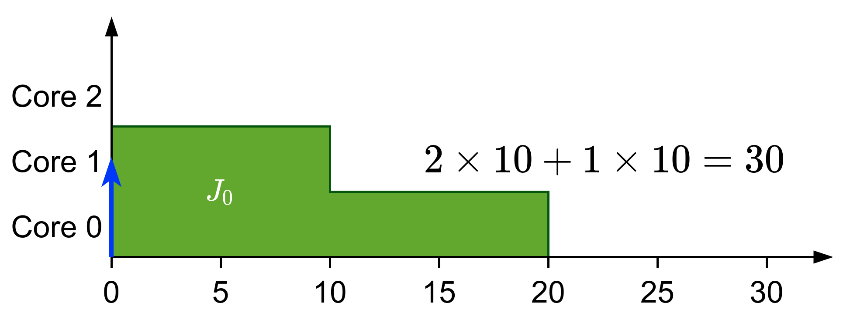
Types of gang
Rigid: number of cores set by programmer
Moldable: number of cores assigned when job is dispatched
Malleable: number of cores can change during runtime
Notes:
Three types:
Rigid gang: Number of cores fixed by programmer
Moldable gang: Number of cores between minimum and maximum. Scheduler chooses at scheduling time.
Malleable gang: Number of cores between minimum and maximum. Can vary during runtime
We choose moldable because:
Rigid can incur in loss of performance if not all cores are actually used
Malleable is hard to implement in reality

Slide 6

Previous work
Introduced in HPC^{[1]}
Preemptive solutions
Non-preemptive
Bundled scheduling^{[6]}
Optimal rigid scheduler
(DP-Fair)^{[2]}
Gang tasks with precedence constraints
Moldable scheduler^{[3]}
Scheduling tests for JLFP^{[4]} and EDF^{[5]}
^{[1]}Ousterhout, 1982
^{[3]}Berten et al., 2011
^{[5]}Kato et al., 2009
[2]Goossens et al., 2016
^{[4]}Goossens et al., 2010
^{[6]}Wasly et al., 2017
Notes:
Introduced in high-performance computing
Real-time:
Fixed-priority is not predictable
Fully-preemptive solutions:
Optimal scheduler for rigid gang but high number of preemptions
Moldable scheduler using moldable property to match deadlines
Bundled scheduling:
Precedence constraints modelled as a succession of bundles
LP definition comes from here
What are the problems that we want to solve?
Gang scheduling works best in non-preemptive solutions but no-one else has worked on that
Rigid and moldable models have overhead when using precedence constraints
There are no good moldable schedulers

Slide 7
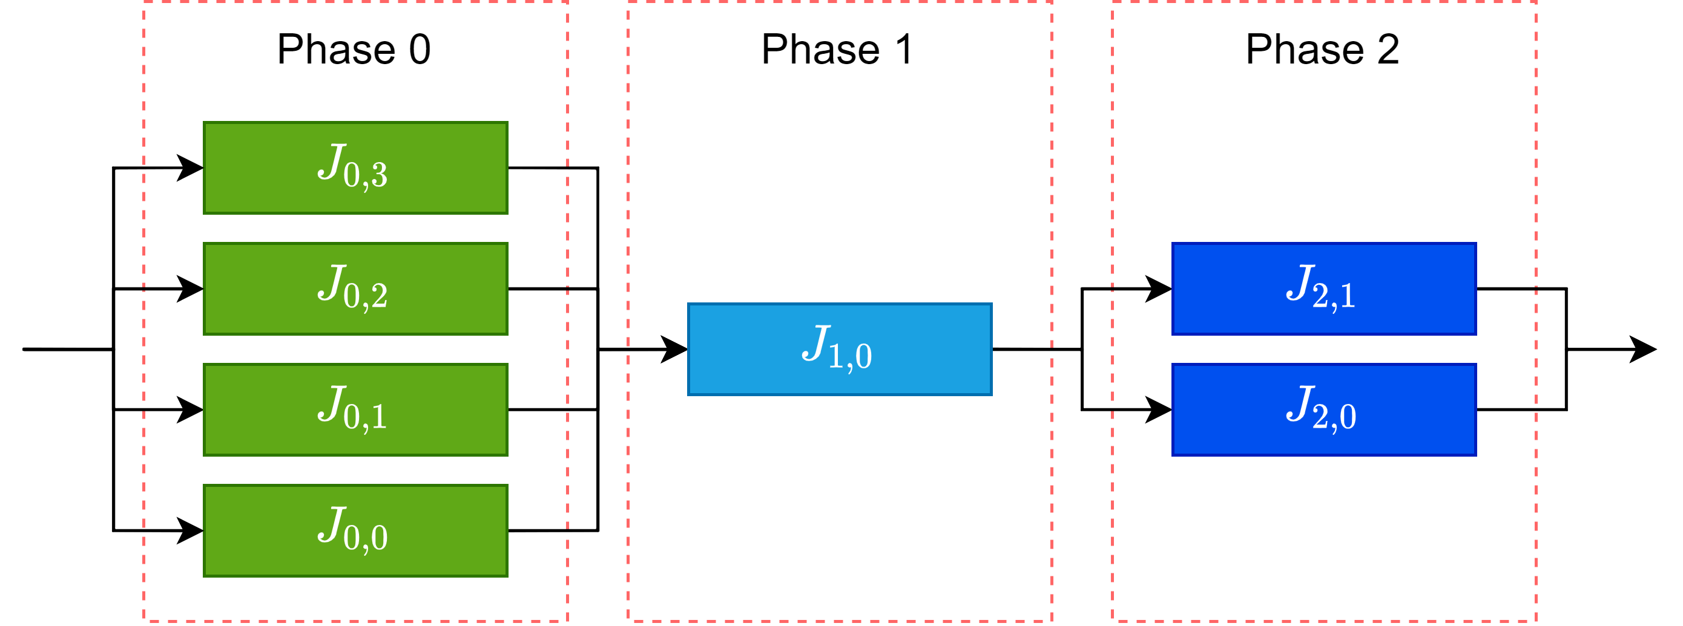
Bundled scheduling vs Limited-Preemptive
Notes:
Example, three bundles.

Slide 8
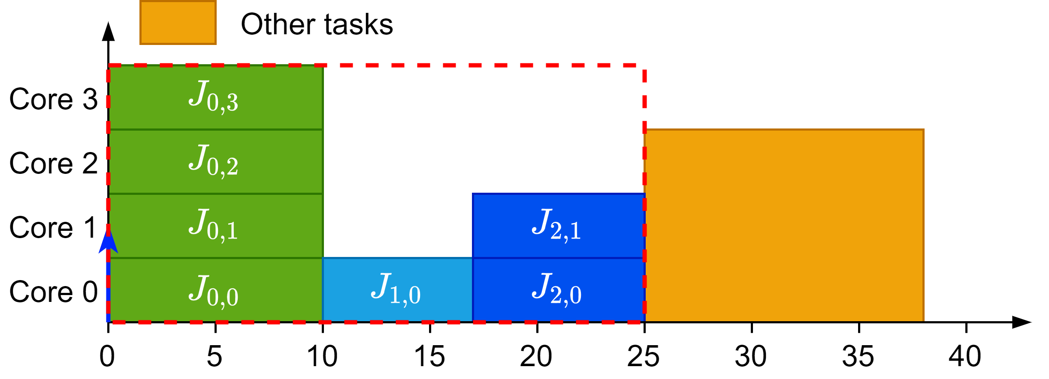
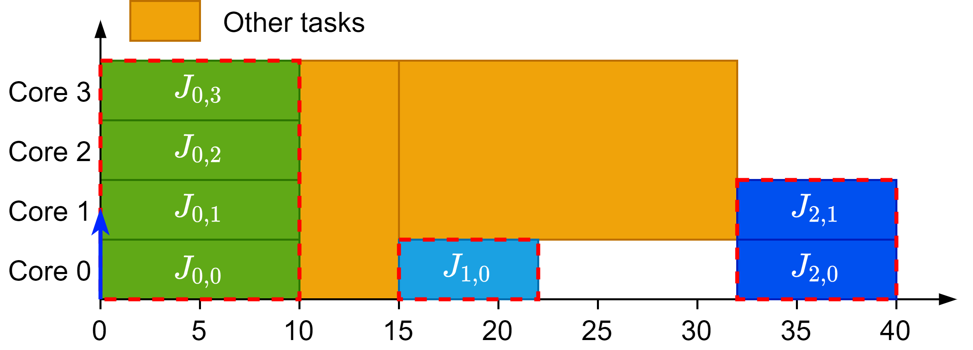
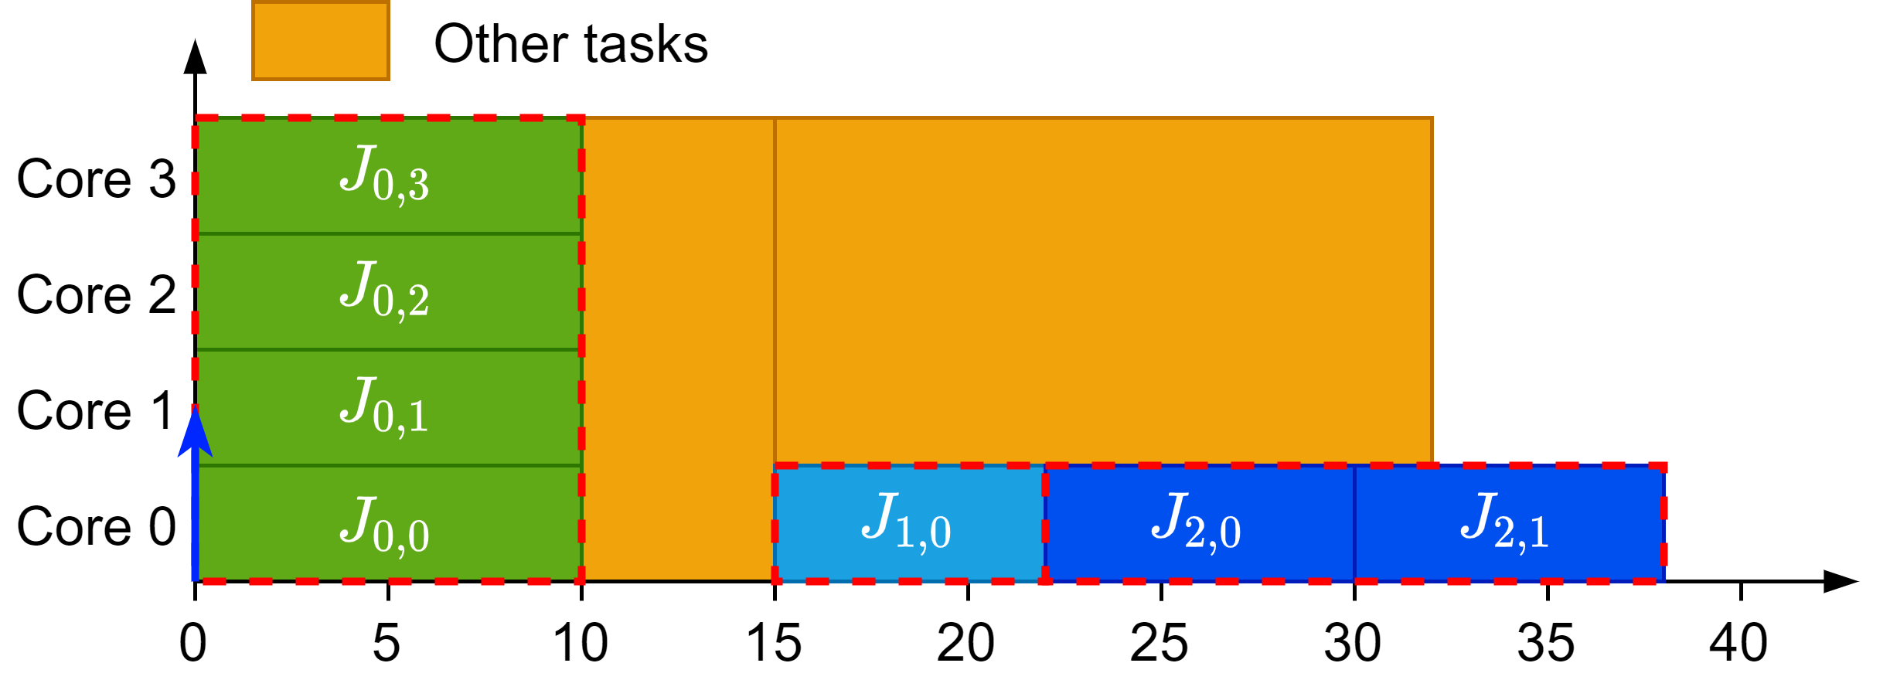
Bundled scheduling vs Limited-Preemptive
Rigid gang reserves the whole block
Bundled creates rigid blocks with dependencies
Limited-Preemptive creates moldable blocks with dependencies
Bundled model scheduling
Limited-Preemptive scheduling
Rigid gang scheduling
Notes:
Rigid gang reserves a whole block for the three bundles
Bundled scheduling creates three individual rigid bundles
Limited-Preemptive creates three individual moldable bundles

Slide 9
Our work

Slide 10
Project goals
Design an accurate schedulability analysis for limited-preemptive moldable gang tasks using schedule abstraction graph
Propose a new scheduling algorithm to improve the schedulability of limited-preemptive moldable gang tasks

Slide 11

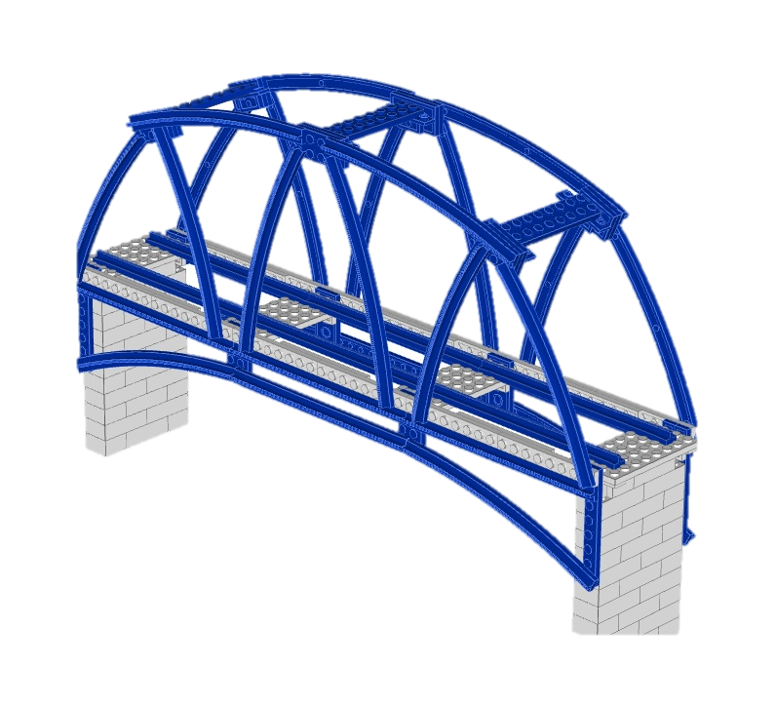
Scheduling analysis state of the art
Exact tests in generic formal verification tools
Response-time analysis using schedule abstraction^{[1]}
Accurate
Easy to extend
Not scalable
Accurate
Relatively fast
Closed-form analyses
Fast
Pessimist
Hard to extend
Industrial use cases are typically large, complex and require accurate analysis
^{[1] Nasri et al., 2018}
Notes:
SAG is the bridge between tests and simulations
Accurate and relatively fast
Explore space of possible schedules
Model scheduler decisions

Slide 12
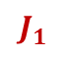
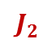
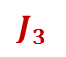
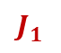
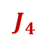
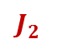
Schedule abstraction graph
It is a technique that allows:
Search for all possible schedules
Aggregate “similar” schedules
$$J_{1}$$
$$J_{2}$$
$$J_{3}$$
$$J_{4}$$
$$J_{2}$$
$$J_{1}$$
Every node is a different system state
Every edge is a different scheduler decision

Slide 13
SAG for gang tasks
Test in simulator
Adapt JLFP to gang
Model gang in SAG
Code new model
Analyse results
Test in SAG
Bugs
Identify issues
Pessimism
Finish

Slide 14
How does JLFP work with gang?
Based on Global JLFP scheduler
Work conserving scheduler
Job with highest priority goes first
All the predecessors of a job must have finished before it can start
Assigns maximum number of available cores to a job between the range of cores that the job allows
Notes:
Explain what variations does JLFP have with gang scheduling

Slide 15
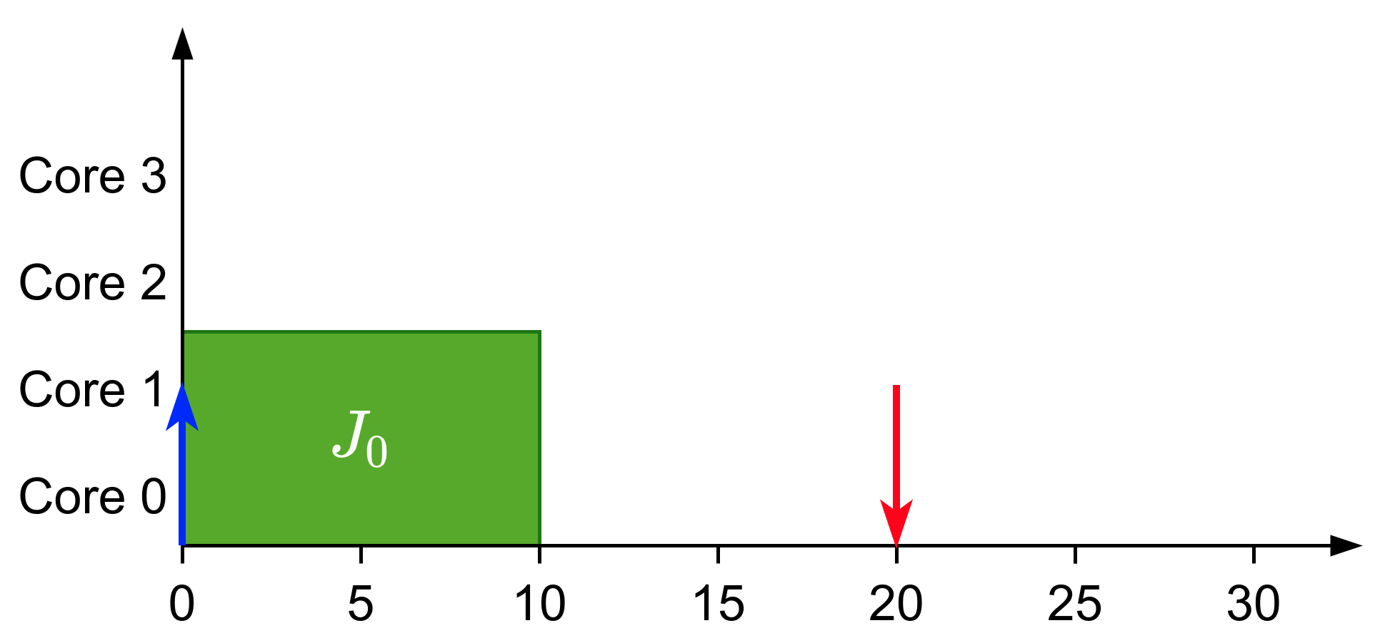
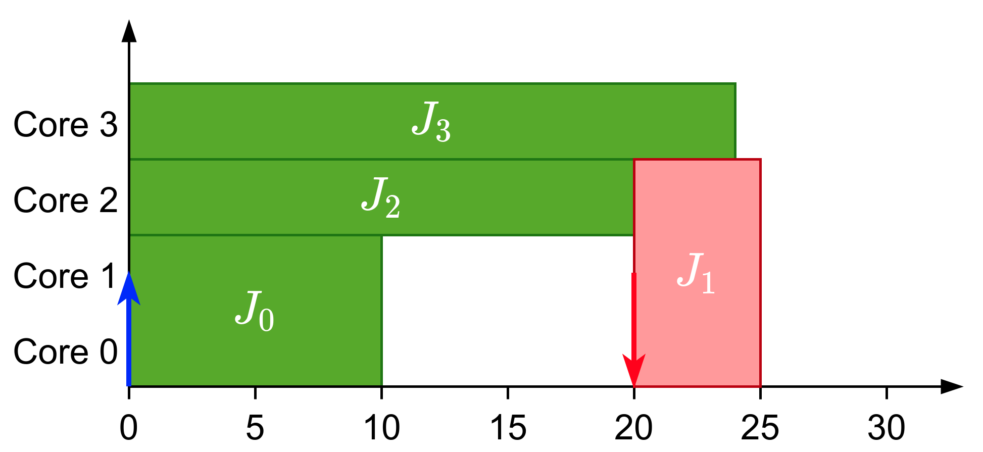
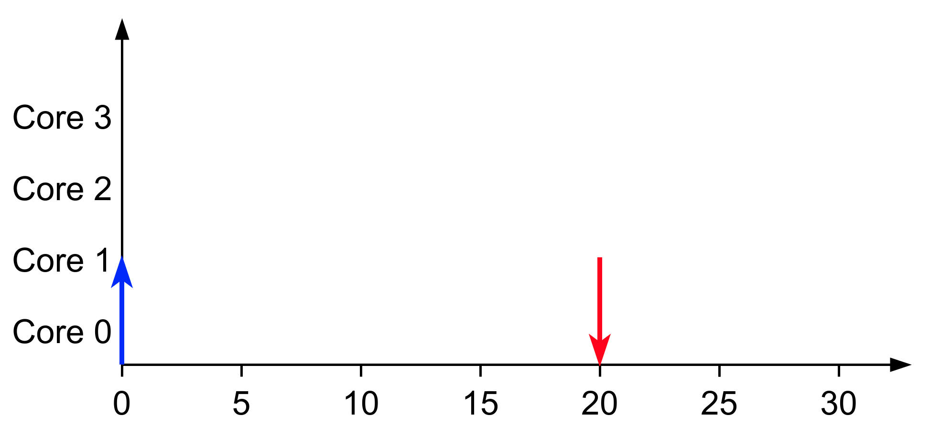
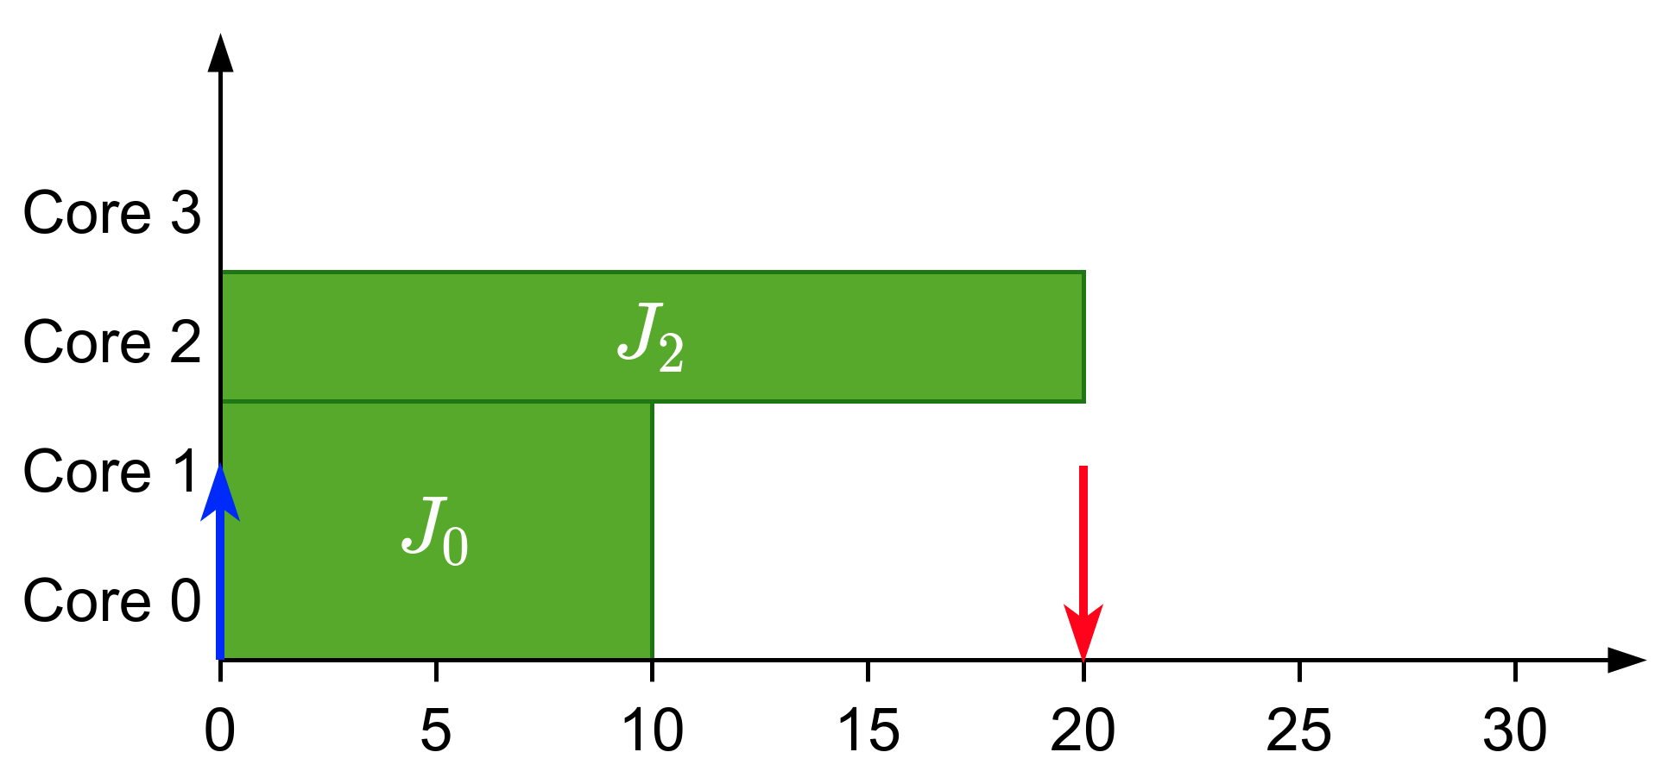
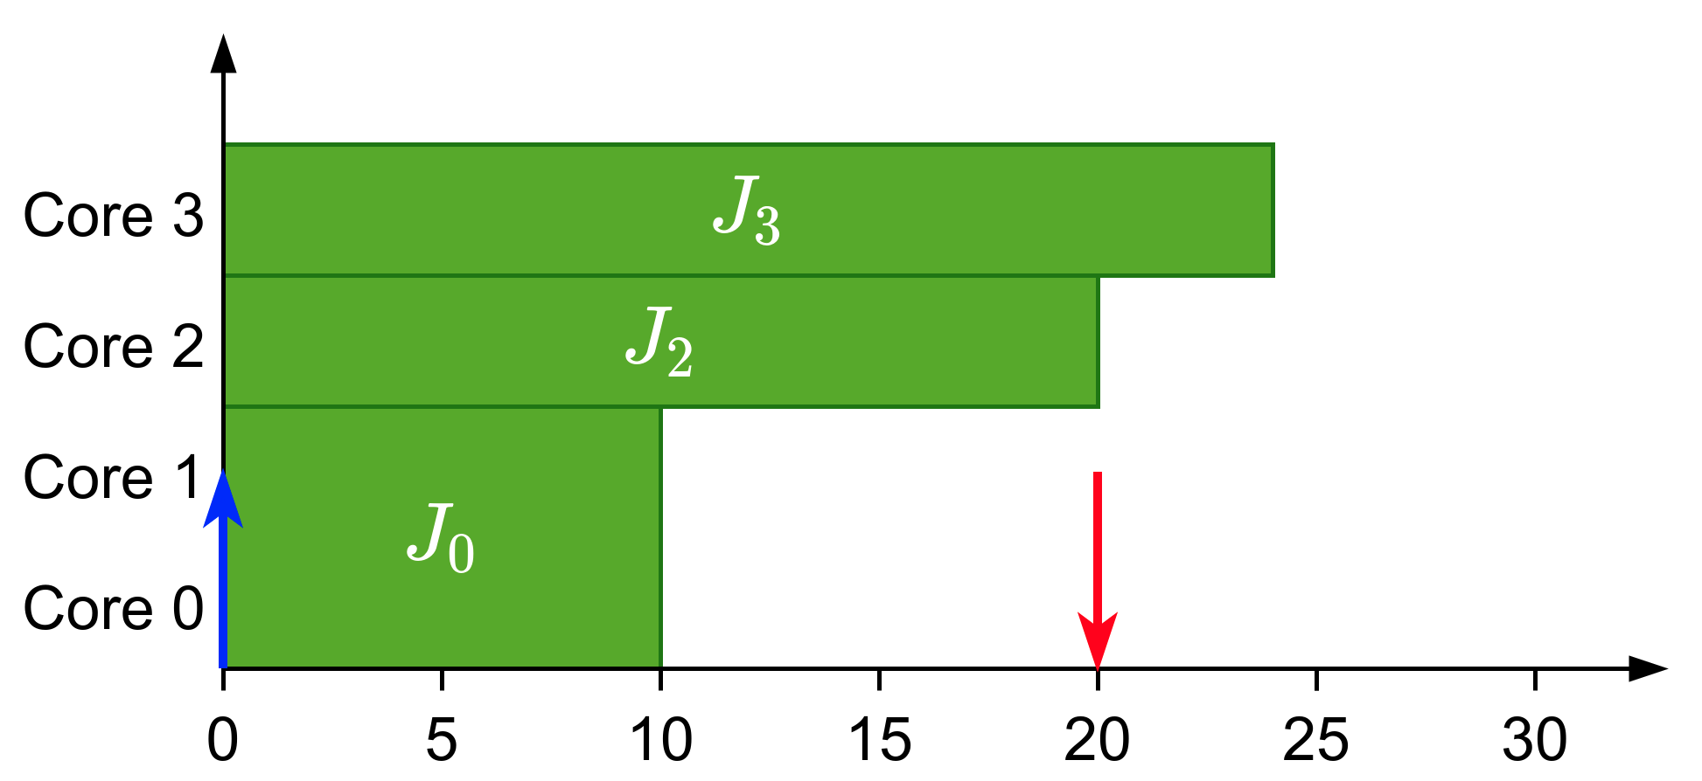
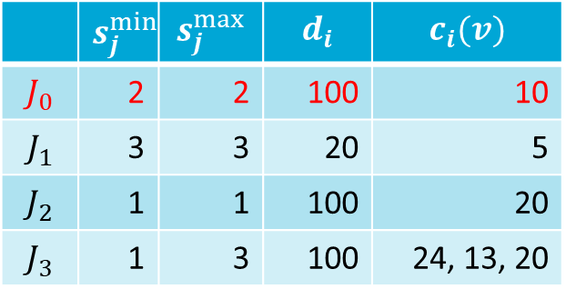
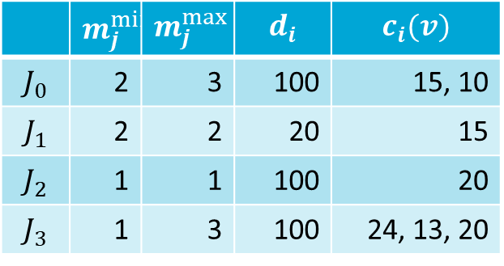
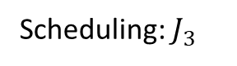
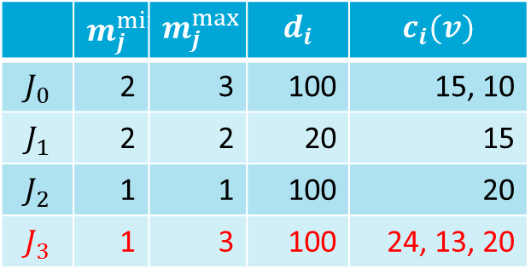
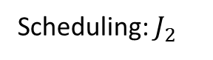
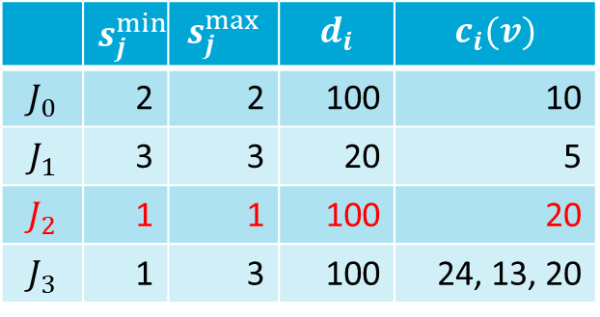
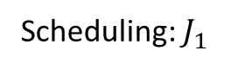
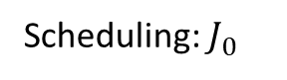
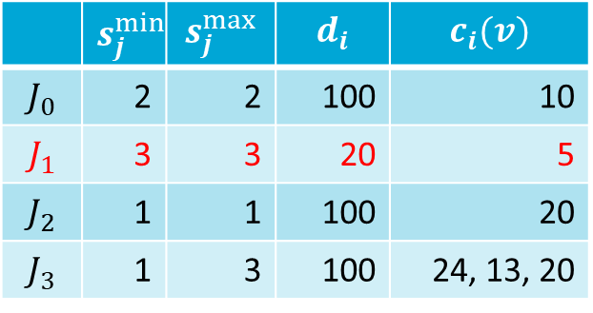
How does JLFP work with gang?
Limited-Preemptive Moldable Reservation Gang Scheduler
Non-work conserving scheduler
Reserve cores of higher-priority tasks and distribute the remaining ones among lower priority tasks
JLFP scheduler
Scheduling: $J_{0}$
Scheduling: $J_{2}$
Scheduling: $J_{3}$
Scheduling: $J_{1}$
 | $$m_{j}^{min}$$ | $$m_{j}^{max}$$ | $$d_{i}$$ | $$c_{i}(v)$$
$$J_{0}$$ | 2 | 3 | 100 | 15, 10
$$J_{1}$$ | 2 | 2 | 20 | 15
$$J_{2}$$ | 1 | 1 | 100 | 20
$$J_{3}$$ | 1 | 3 | 100 | 24, 13, 20
 | $$s_{j}^{min}$$ | $$s_{j}^{max}$$ | $$d_{i}$$ | $$c_{i}(v)$$
$$J_{0}$$ | 2 | 2 | 100 | 10
$$J_{1}$$ | 3 | 3 | 20 | 5
$$J_{2}$$ | 1 | 1 | 100 | 20
$$J_{3}$$ | 1 | 3 | 100 | 24, 13, 20
 | $$s_{j}^{min}$$ | $$s_{j}^{max}$$ | $$d_{i}$$ | $$c_{i}(v)$$
$$J_{0}$$ | 2 | 2 | 100 | 10
$$J_{1}$$ | 3 | 3 | 20 | 5
$$J_{2}$$ | 1 | 1 | 100 | 20
$$J_{3}$$ | 1 | 3 | 100 | 24, 13, 20
 | $$s_{j}^{min}$$ | $$s_{j}^{max}$$ | $$d_{i}$$ | $$c_{i}(v)$$
$$J_{0}$$ | 2 | 2 | 100 | 10
$$J_{1}$$ | 3 | 3 | 20 | 5
$$J_{2}$$ | 1 | 1 | 100 | 20
$$J_{3}$$ | 1 | 3 | 100 | 24, 13, 20
 | $$m_{j}^{min}$$ | $$m_{j}^{max}$$ | $$d_{i}$$ | $$c_{i}(v)$$
$$J_{0}$$ | 2 | 3 | 100 | 15, 10
$$J_{1}$$ | 2 | 2 | 20 | 15
$$J_{2}$$ | 1 | 1 | 100 | 20
$$J_{3}$$ | 1 | 3 | 100 | 24, 13, 20

Slide 16
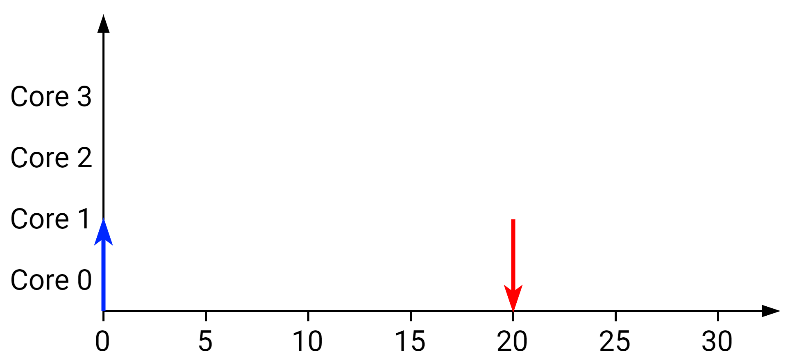
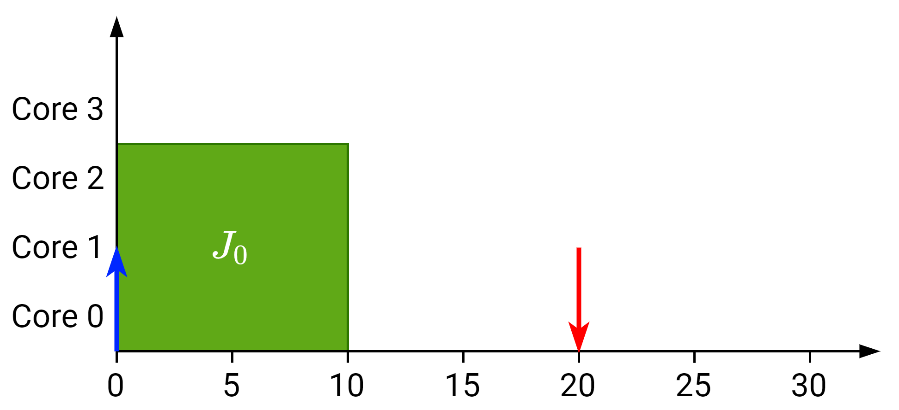
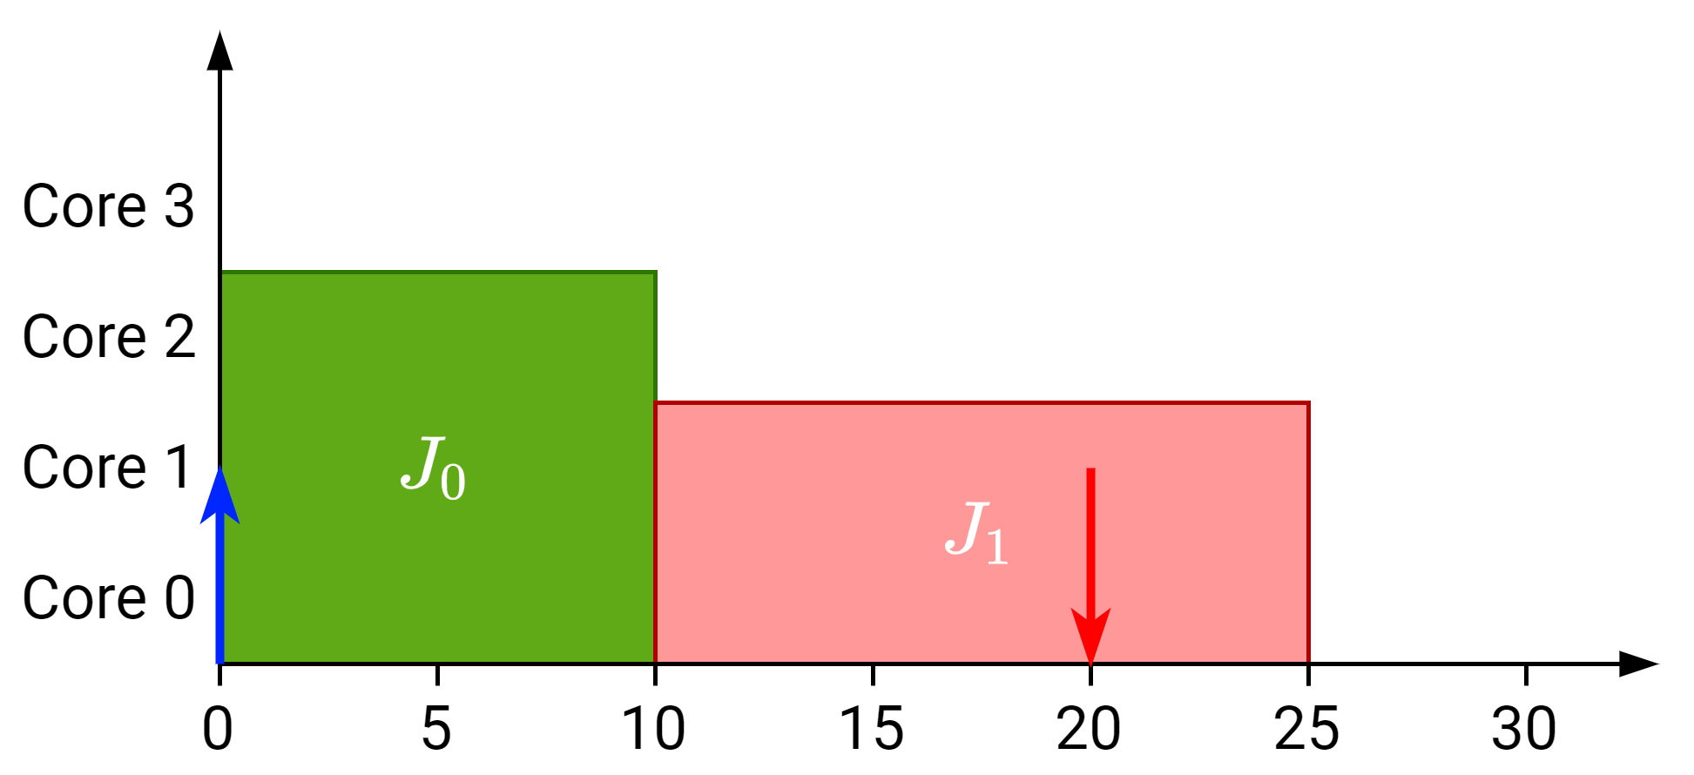
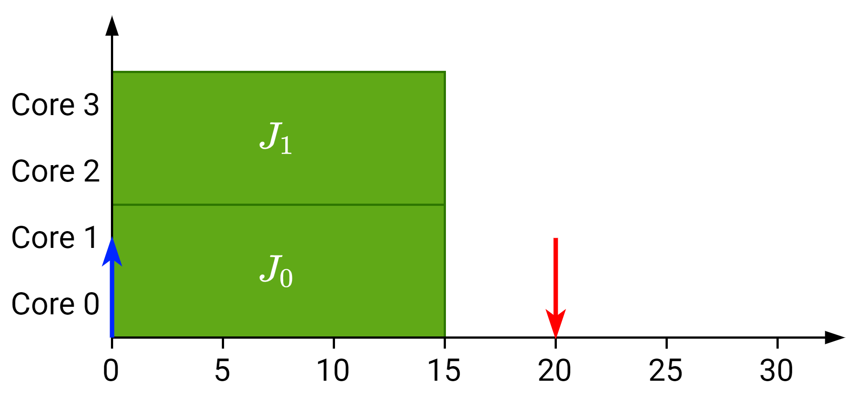
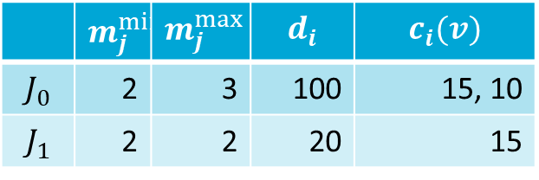
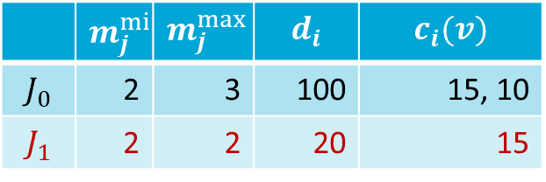
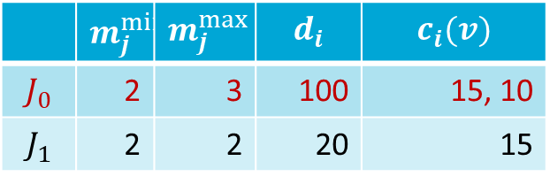
How does JLFP work with gang?
Based on Global JLFP scheduler
Assigns maximum number of available cores to a job between the range of cores that the job allows
JLFP scheduler
 | $$m_{j}^{min}$$ | $$m_{j}^{max}$$ | $$d_{i}$$ | $$c_{i}(v)$$
$$J_{0}$$ | 2 | 3 | 100 | 15, 10
$$J_{1}$$ | 2 | 2 | 20 | 15
Scheduling: $J_{0}$
 | $$m_{j}^{min}$$ | $$m_{j}^{max}$$ | $$d_{i}$$ | $$c_{i}(v)$$
$$J_{0}$$ | 2 | 3 | 100 | 15, 10
$$J_{1}$$ | 2 | 2 | 20 | 15
Scheduling: $J_{1}$
 | $$m_{j}^{min}$$ | $$m_{j}^{max}$$ | $$d_{i}$$ | $$c_{i}(v)$$
$$J_{0}$$ | 2 | 3 | 100 | 15, 10
$$J_{1}$$ | 2 | 2 | 20 | 15

Slide 17
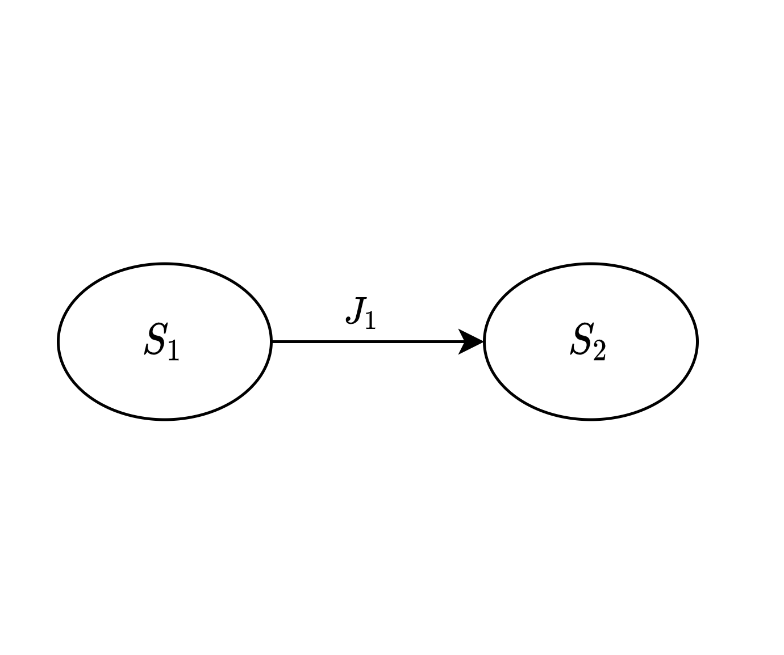
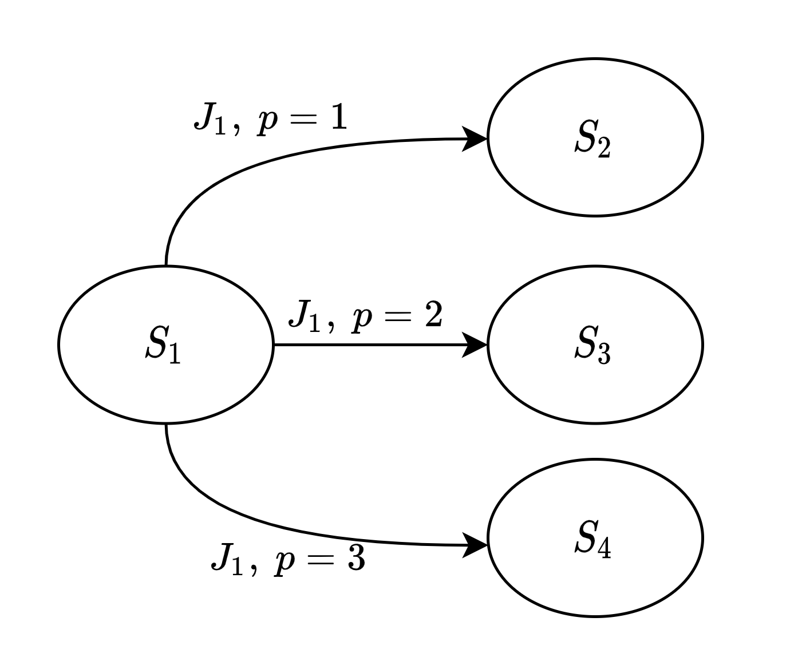
SAG analysis changes for gang
Previously a state was created for every schedulable job
Now a state is created for every job and possible number of cores

Slide 18
SAG evaluation
Generate gang task sets
Make sure that they are schedulable without any variation by using a simulator
Compare results with SAG results
Without variation they should match exactly
Used for testing of proper implementation
Generate results with execution time variation and/or release jitter

Slide 19
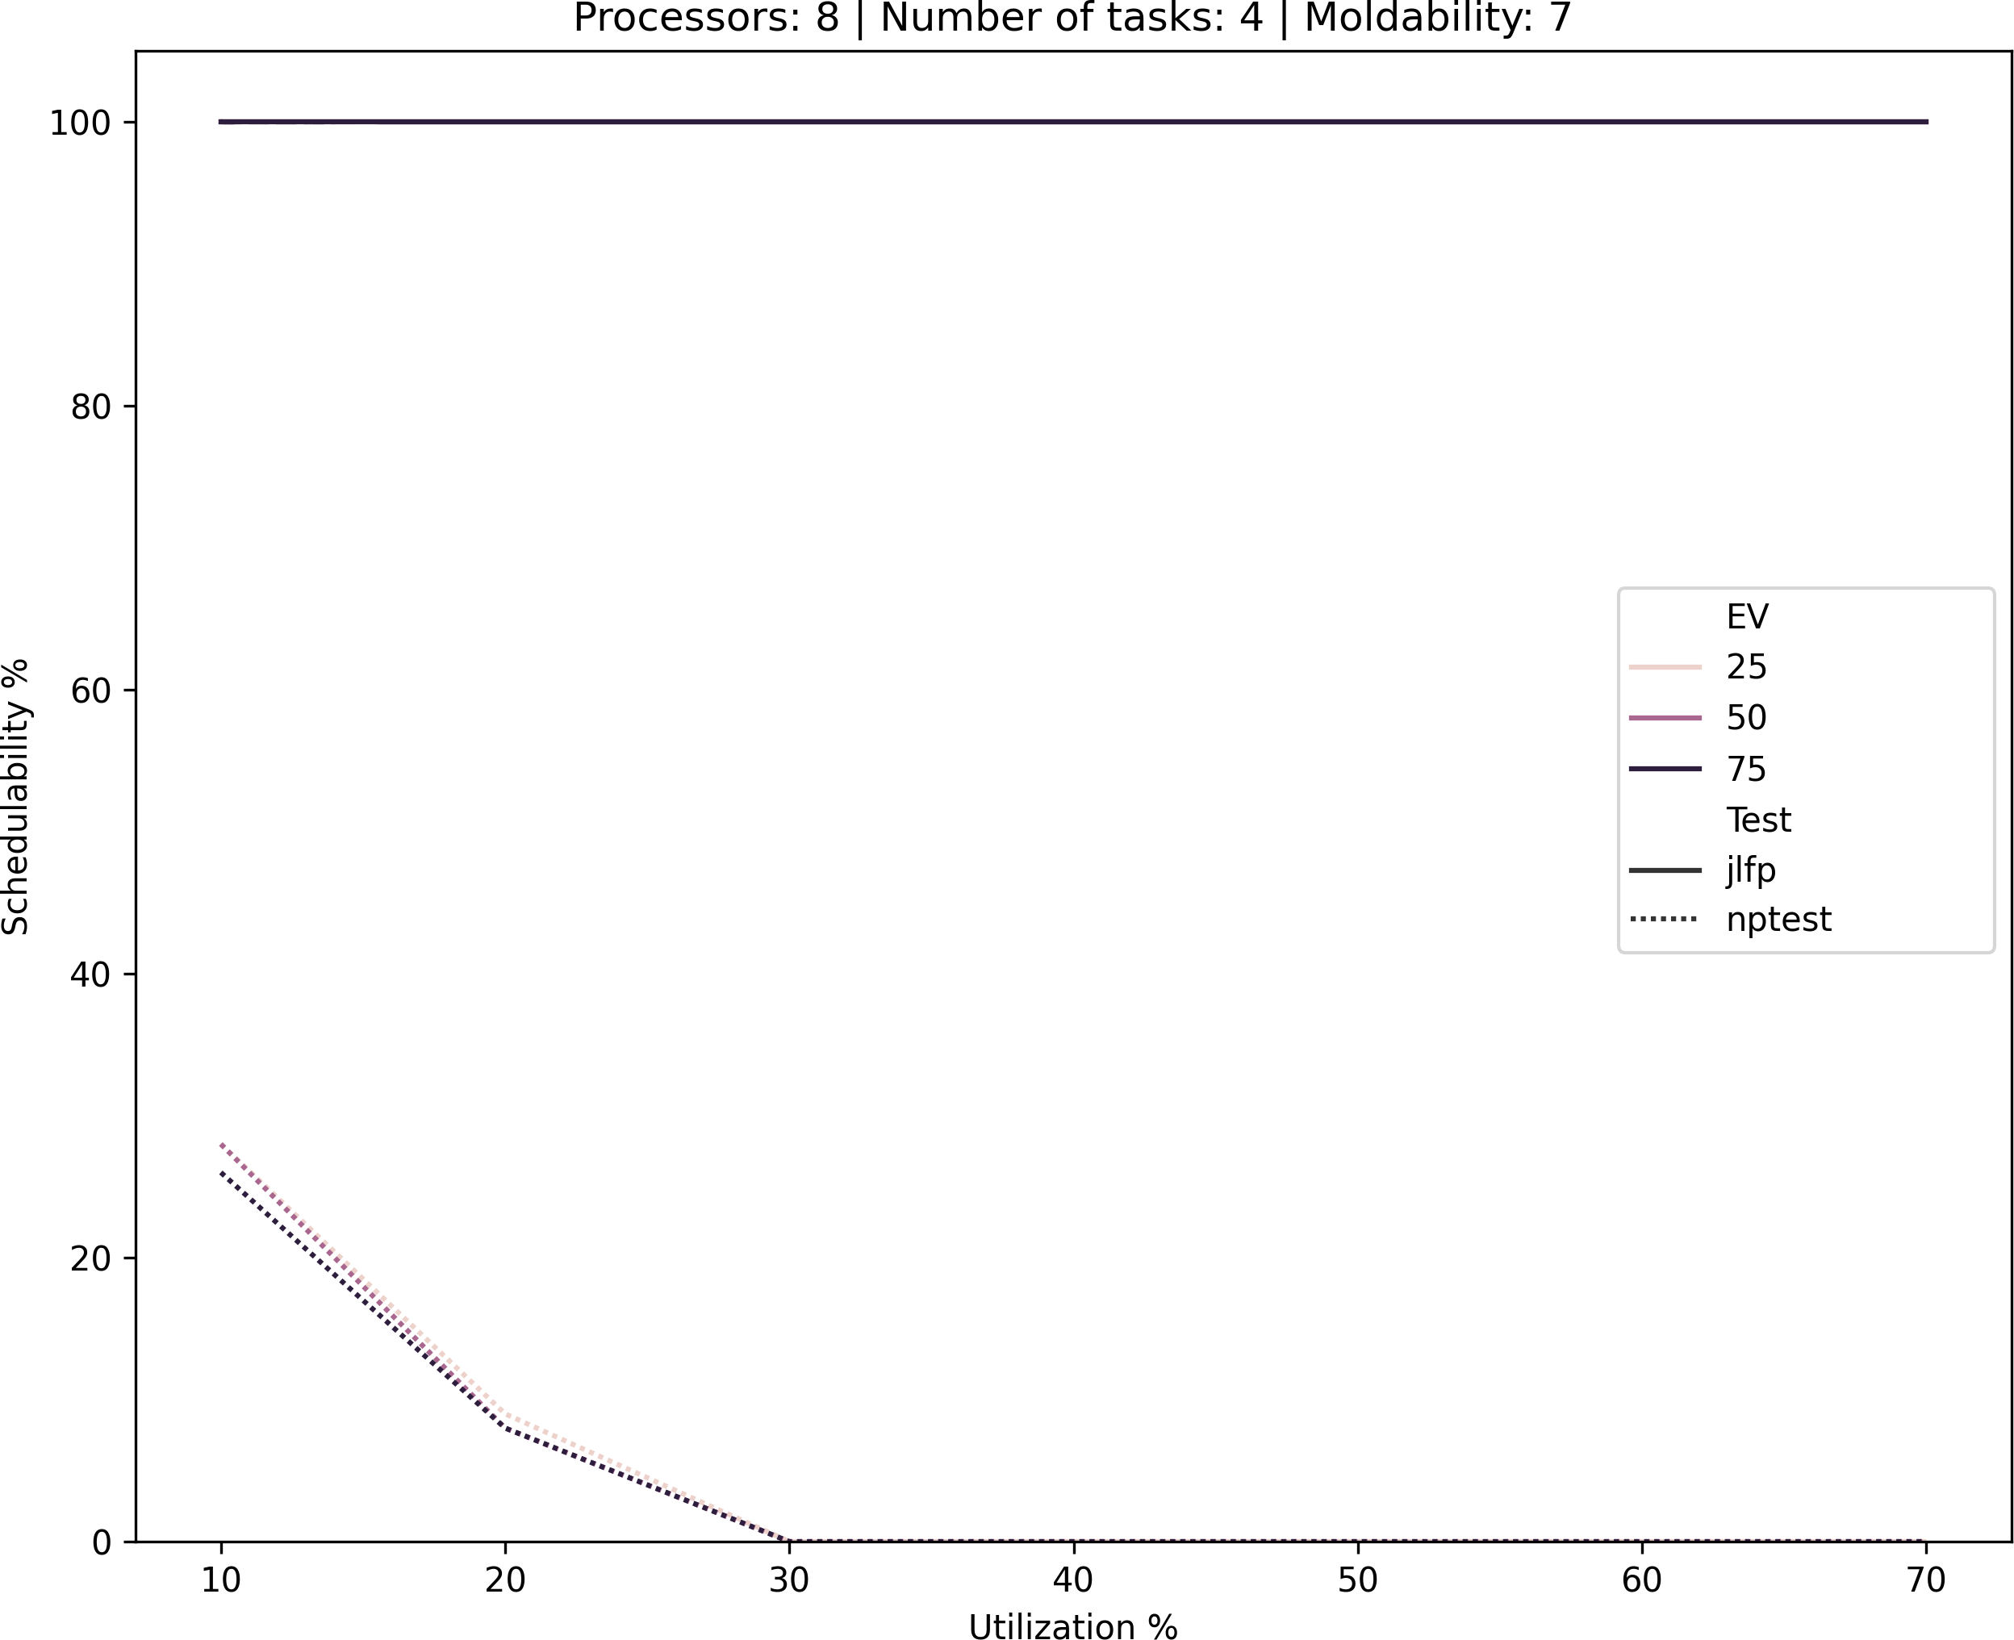
Primary results
Either
Gang is not what we expected
There are issues in the analysis
We can do better

Slide 20
Issues identified
State explosions
Precedence constraints were ignored (bug in code)
The new generated state was not entirely correct
Sources of pessimism
Precedence constraints of higher priority jobs were ignored
The analysis was not using the fact that multiple cores may be released at once
Fixed

Slide 21
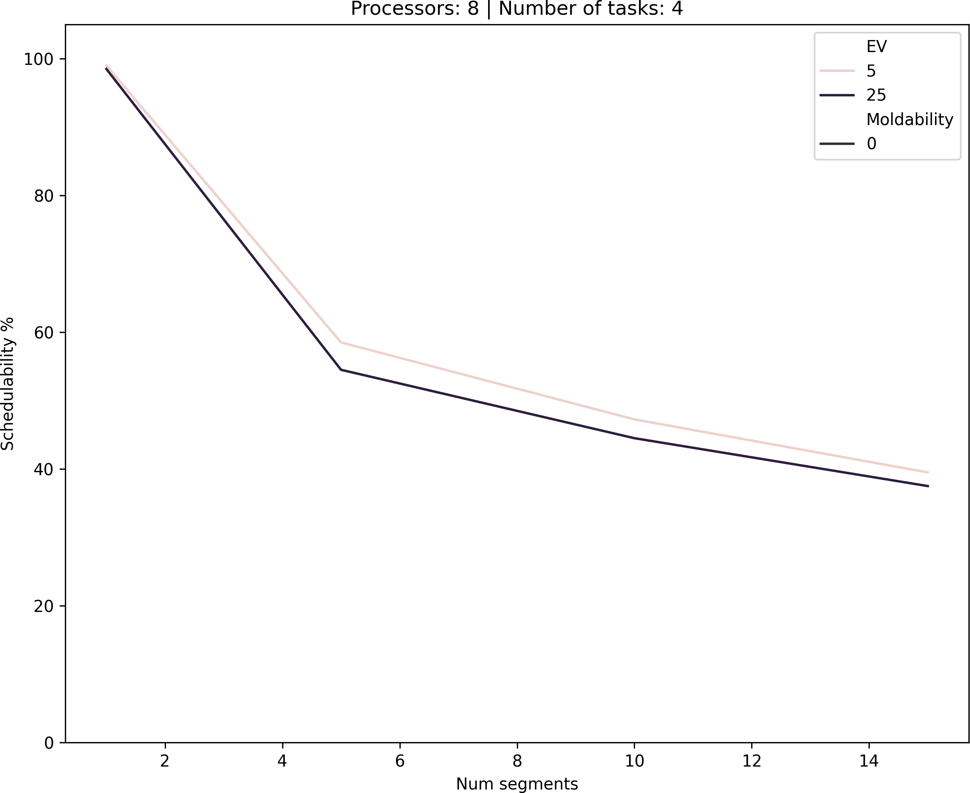
Pessimism in precedence constraints

Slide 22
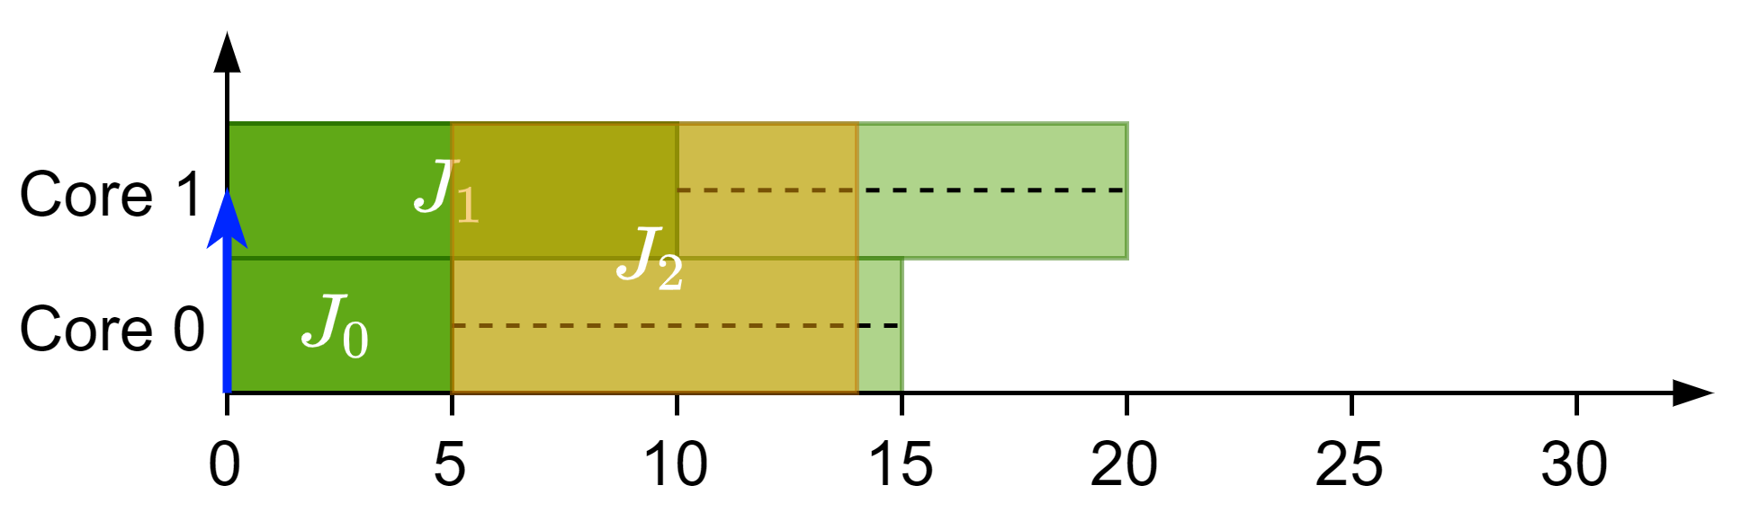
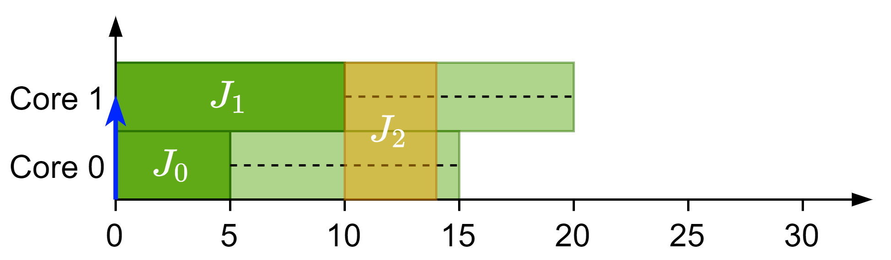
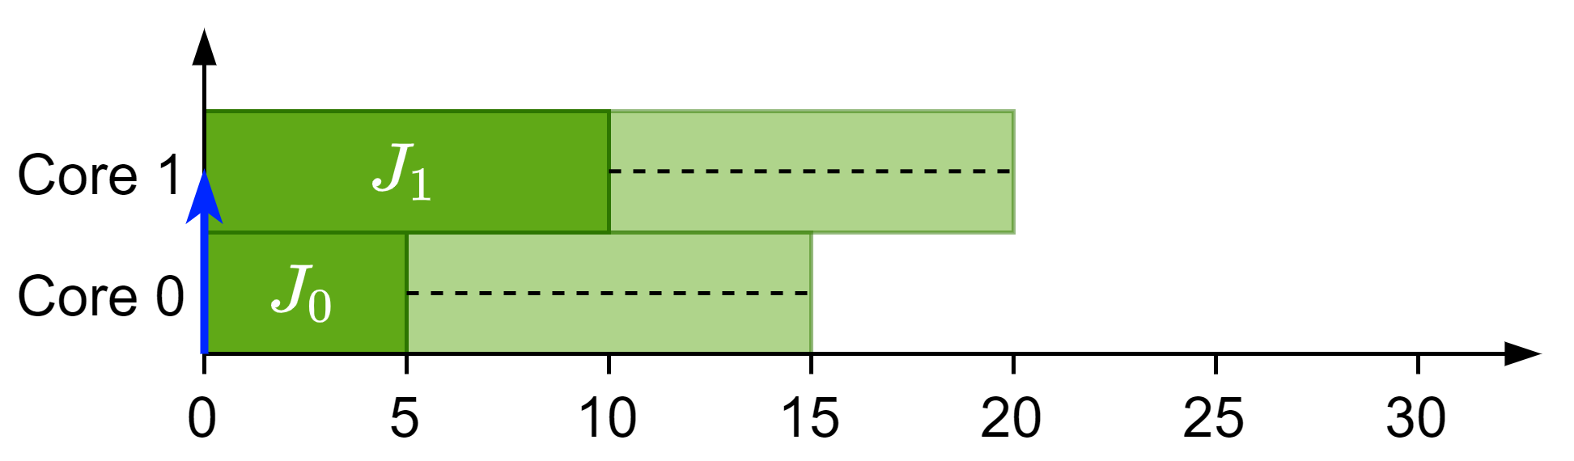

Pessimism in precedence constraints
$J_{2}$ is ready
$J_{0}$ has a successor with higher priority than $J_{2}$
$J_{2}$ should never be able to start after $J_{0}$ finishes as the successor would start right away
Actual
Expected

Slide 23

Pessimism in cores released
TODO: Change this image for the new one

Slide 24






Pessimism in cores released
The analysis does not make difference between:
Multiple jobs finishing
One job finishing with multiple cores
The new job considers all the cores as individual jobs
Does not make the analysis invalid, just more pessimistic
Solving this makes the analysis faster

Slide 25


Pessimism in cores released

Slide 26
New scheduler

Slide 27











New Scheduler
Limited-Preemptive Moldable Reservation Gang Scheduler
Non-work conserving scheduler
Reserve cores of higher-priority tasks and distribute the remaining ones among lower priority tasks
LPMRGS scheduler
Scheduling: $J_{0}$
Scheduling: $J_{2}$
Scheduling: $J_{3}$
Scheduling: $J_{1}$
 | $$s_{j}^{min}$$ | $$s_{j}^{max}$$ | $$d_{i}$$ | $$c_{i}(v)$$
$$J_{0}$$ | 2 | 2 | 100 | 10
$$J_{1}$$ | 3 | 3 | 20 | 5
$$J_{2}$$ | 1 | 1 | 100 | 20
$$J_{3}$$ | 1 | 3 | 100 | 24, 13, 20
 | $$s_{j}^{min}$$ | $$s_{j}^{max}$$ | $$d_{i}$$ | $$c_{i}(v)$$
$$J_{0}$$ | 2 | 2 | 100 | 10
$$J_{1}$$ | 3 | 3 | 20 | 5
$$J_{2}$$ | 1 | 1 | 100 | 20
$$J_{3}$$ | 1 | 3 | 100 | 24, 13, 20
 | $$s_{j}^{min}$$ | $$s_{j}^{max}$$ | $$d_{i}$$ | $$c_{i}(v)$$
$$J_{0}$$ | 2 | 2 | 100 | 10
$$J_{1}$$ | 3 | 3 | 20 | 5
$$J_{2}$$ | 1 | 1 | 100 | 20
$$J_{3}$$ | 1 | 3 | 100 | 24, 13, 20
 | $$s_{j}^{min}$$ | $$s_{j}^{max}$$ | $$d_{i}$$ | $$c_{i}(v)$$
$$J_{0}$$ | 2 | 2 | 100 | 10
$$J_{1}$$ | 3 | 3 | 20 | 5
$$J_{2}$$ | 1 | 1 | 100 | 20
$$J_{3}$$ | 1 | 3 | 100 | 24, 13, 20
 | $$s_{j}^{min}$$ | $$s_{j}^{max}$$ | $$d_{i}$$ | $$c_{i}(v)$$
$$J_{0}$$ | 2 | 2 | 100 | 10
$$J_{1}$$ | 3 | 3 | 20 | 5
$$J_{2}$$ | 1 | 1 | 100 | 20
$$J_{3}$$ | 1 | 3 | 100 | 24, 13, 20

Slide 28
Testing new scheduler
Tested on simulator
We want to test it now with schedule abstraction graph to see if it performs better than JLFP under execution variation possibilities

Slide 29
Results JLFP vs new scheduler
Insert plot here comparing the two

Slide 30
Conclusions
Gang scheduling is an interesting problem with a lot that can be done
It is possible to define an analysis with SAG for gang
The analysis is too pessimistic
The issues have been identified, a fix is on the way
Gang moldable properties have potential yet to be unlocked
Questions?

Slide 31
Colours
Primary
Boxes
Borders
Emphasis
Notes:
SAG is the bridge between tests and simulations
Accurate and relatively fast
Explore space of possible schedules
Model scheduler decisions

Slide 32
Scheduling Analysis
Schedule Abstraction
Graph^{[1]}
Simulations
Scheduling tests
Exact
Slow
Pessimist
Fast
Accurate
Relatively fast
Explore space of possible schedules for a given job set
Models scheduler decisions
^{[1] Nasri et al., 2018}
Notes:
SAG is the bridge between tests and simulations
Accurate and relatively fast
Explore space of possible schedules
Model scheduler decisions

Slide 33





















How does SAG work?
$$J_{i}$$ | $$C_{i}^{min}$$ | $$C_{i}^{max}$$ | $$r_{i}$$ | $$d_{i}$$ | $$P_{i}$$
$$J_{1}$$ | 10 | 15 | 10 | 30 | 1
$$J_{2}$$ | 5 | 5 | 0 | 100 | 2
$$J_{i}$$ | $$C_{i}^{min}$$ | $$C_{i}^{max}$$ | $$r_{i}$$ | $$d_{i}$$ | $$P_{i}$$
$$J_{1}$$ | 10 | 15 | 10 | 30 | 1
$$J_{2}$$ | 5 | 5 | 0 | 100 | 2
$$J_{i}$$ | $$C_{i}^{min}$$ | $$C_{i}^{max}$$ | $$r_{i}$$ | $$d_{i}$$ | $$P_{i}$$
$$J_{1}$$ | 10 | 15 | 10 | 30 | 1
$$J_{2}$$ | 5 | 5 | 0 | 00 | 2
$$J_{i}$$ | $$C_{i}^{min}$$ | $$C_{i}^{max}$$ | $$r_{i}$$ | $$d_{i}$$ | $$P_{i}$$
$$J_{1}$$ | 10 | 15 | 10 | 30 | 1
$$J_{2}$$ | 5 | 5 | 0 | 00 | 2
$$J_{i}$$ | $$C_{i}^{min}$$ | $$C_{i}^{max}$$ | $$r_{i}$$ | $$d_{i}$$ | $$P_{i}$$
$$J_{1}$$ | 10 | 15 | 10 | 30 | 1
$$J_{2}$$ | 5 | 5 | 0 | 00 | 2
$$J_{i}$$ | $$C_{i}^{min}$$ | $$C_{i}^{max}$$ | $$r_{i}$$ | $$d_{i}$$ | $$P_{i}$$
$$J_{1}$$ | 10 | 15 | 10 | 30 | 1
$$J_{2}$$ | 5 | 5 | 0 | 00 | 2
Notes:
Example of graph exploration:
If $J_{1}$ goes first no deadline miss
If $J_{2}$ goes first then $J_{1}$ has a deadline miss later

Slide 34
Results method
Generate random task set
Minimum and maximum number of cores fixed
Total task cost is divided by number of cores
10 segments per task
Make sure that the task set can be executed non-pre-emptively with JLFP and no jitter or execution time variation
Test task set with SAG
Generate 100 task sets per data point for:
Utilization 10% to 90%
Moldability from 0 to 7
Total cores = 8

Slide 35
Why these results?
There is pessimism in the SAG definition for:
Precedence constraints
Gang scheduling
We can solve it

Slide 36
Difficulties related to SAG
We have to consider all scenarios.
The scheduler has to decide:
When to release a job
How many cores to assign to this job

Slide 37
SAG for gang tasks
Adaptation of JLFP for gang tasks
Changes required in SAG to model gang tasks
Testing method
Generate tasks
Execute them without any variation and expect the same results as the simulator
Issues identified
The definition of certainly running jobs was not strict enough
Precedence constraints is too pessimistic
The first implementation of gang scheduling was too pessimistic. It is now fixed

